Slide 1
Chongqing University of Technology
ATAI
Advanced Technique of Artificial Intelligence
Chongqing University of Technology
Bridging the Structural Gap Between Encoding and Decoding for Data-To-Text Generation
Chao Zhao, Marilyn Walker and Snigdha Chaturvedi(ACL-2020)
Department of Computer Science, University of North Carolina at Chapel Hill Natural Language and Dialog Systems Lab, University of California, Santa Cruz
{zhaochao, snigdha}@cs.unc.edu mawalker@ucsc.edu
2020.11.28 • ChongQing
Reported by LeLe Duan
Code&dataset:https://github.com/ zhaochaocs/DualEnc

Slide 2
Chongqing University of Technology
ATAI
Advanced Technique of Artificial Intelligence
Chongqing University of Technology
1.Introduction
2.Method
3.Experiments
4.Conclusion

Slide 3
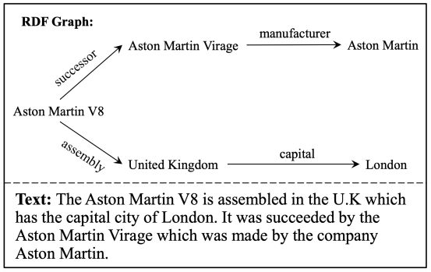
Introduction
Focusing on Structure data to text generation
Previous work:
Seq2Seq generation
Graph2Seq generation
the source data is an RDF graph and the target output is a text description of the graph.

Slide 4
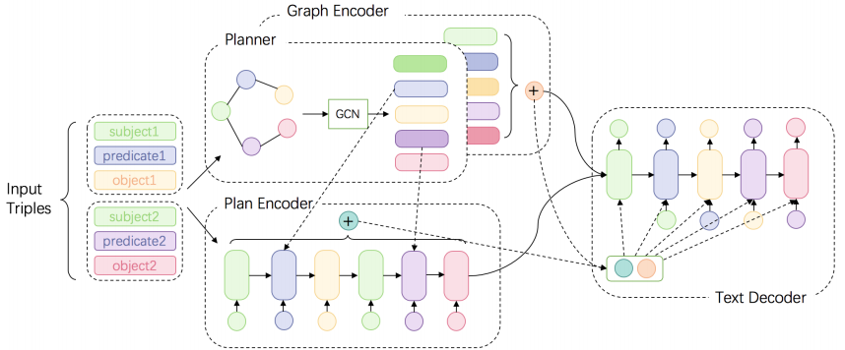
Method
Dual Encoding Model
Input:a set of RDF triples
A RDF triple:

Slide 5
Method
Dual Encoding Model
reconstruct the input graph:
Regard the s, p, and o as three kinds of nodes
Identifing s and o by their entity mentions
Identifing p by a unique ID

Slide 6
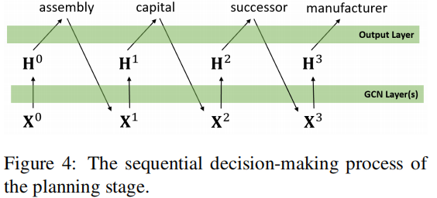
Method
GCN②
Dual Encoding Model
GCN for encoding
Where ,
is the average embedding of the node mentions
GCN① for plan

Slide 7
Method
Dual Encoding Model
After planning, add delimiters among words:

Slide 8
Method
Dual Encoding Model
GCN2
LSTM-based decoder with an attention and copy mechanism.
Two strategies for inputting context to the decoder：
PLANENC：only use hidden states of the plan encoder
DUALENC：incorporate the graph and the plan
GCN1
$$z_{0}$$
$$m_{t}$$
$z_{0}$is the summation of the final states from the two encoders,$y_{t−1}$is the embedding of the previously generated token

Slide 9
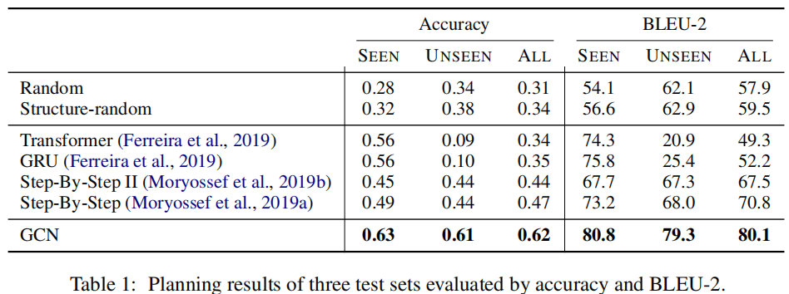
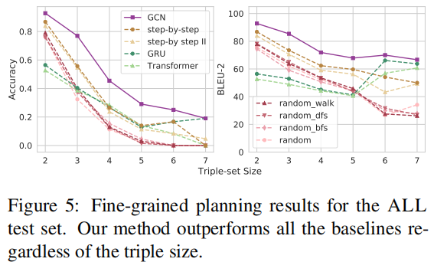
Experiment
Plan Generation：

Slide 10
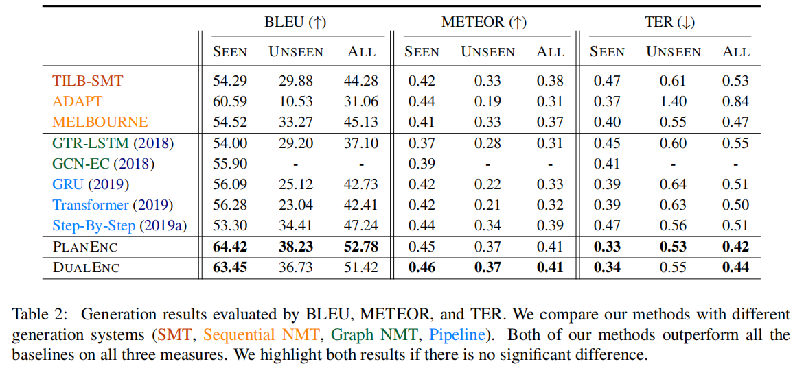
Experiment
Text Generation .

Slide 11
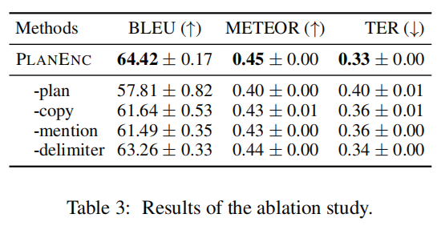
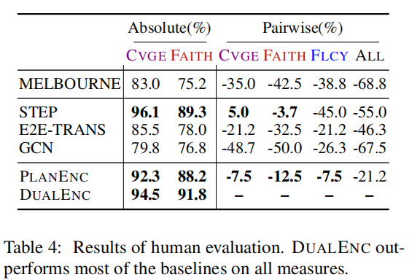
Experiment
Ablation study
Human evaluation

Slide 12
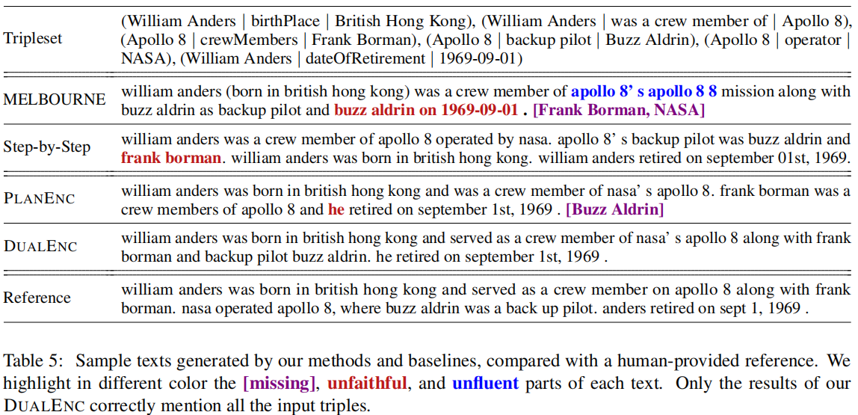
Experiment
Case study

Slide 13
Conclusion
GCN encoders to capture the structural information of the data.
Introduce an intermediate content planning stage to serialize the data.
Dual encoding method simultaneously captures information from the original data and the corresponding plan.

Slide 14
Chongqing University of Technology
ATAI
Advanced Technique of Artificial Intelligence
Chongqing University of Technology
Thank you!

